Slide 1
Introduction to Neural Networks
By: Joel Osei-Asamoah
Notes:
Make it a point to let the students “know” that this is just an Introduction to Neural Networks so the goal of this class is just to ensure that they understand how neural networks work intuitively and also from this lecture they should be able to grasp an understanding of concepts to enable them to use neural networks in their final Project

Slide 2
What is a Neural Network ?
Notes:
Here ask students this question and give them time to think and come up with answers for what they think a neural network is

Slide 3
“A neural network is a computational model inspired by the human brain, designed to recognize patterns and relationships in data. It takes inputs, processes them through layers of interconnected nodes (neurons), and produces outputs, like making predictions or classifications.”

Slide 4
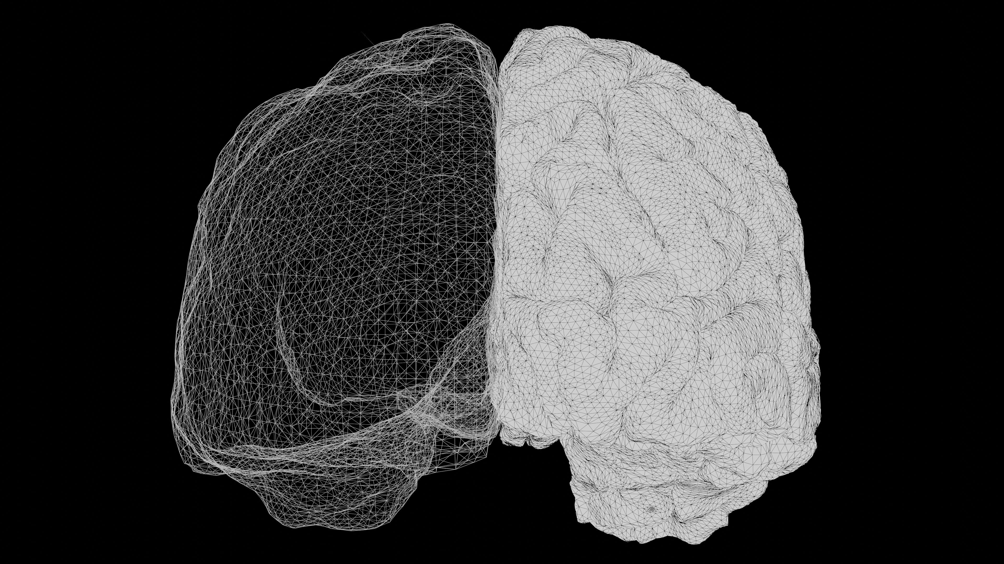
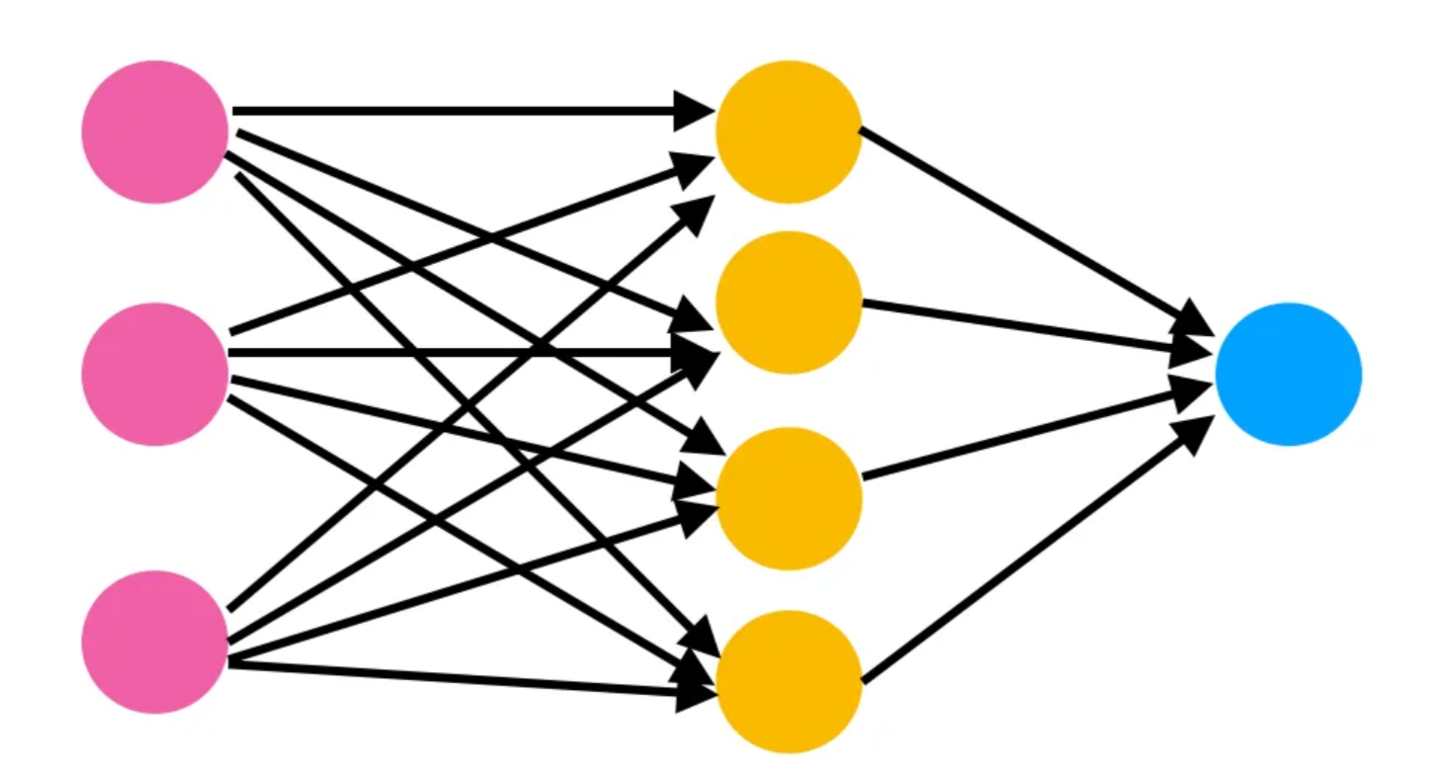
Neural Networks and The Brain
Notes:
Draw a neuron on the board and work from how the neurons in the brain work to how neural networks operate on a very high level ! Neurons receive input from the Dendrites, The Soma (cell body) processes it and then the axon transmits it to the next neuron, depending on the task you are doing, some connections are strong than others. Ask Students why they think scientists thought it was a good reason to use how the brain works to create a machine learning model ?

Slide 5
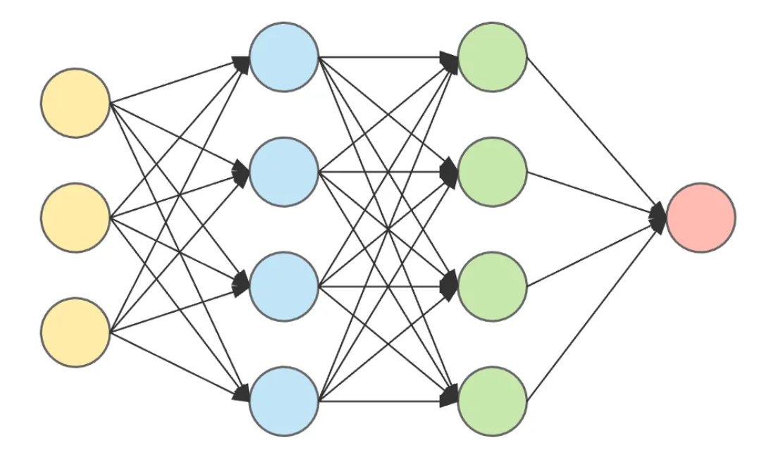
Structure of Neural Networks
Output Layer
Input Layer
Hidden Layer 1
Hidden Layer 2
Notes:
Let them know that to understand neural networks, we need to understand its essential building blocks
A Layer is a set of Neurons not connected to each other
First neural networks are made of layers
Input Layer: Receive Raw Features (You can give an example with your capstone and what it was receiving)
Hidden Layers: Perform computations by transforming data through weights and activation functions
Output Layer: Produces Predictions or Classification (Again use example of your capstone)
Talk about how the setup of your layers makes up your architecture

Slide 6
The Neuron
Each Neuron is made up of Weights and Activation Function
Weights determine the importance of each input, they are adjusted during training to make the network’s prediction more accurate (Biases Do Same)
Activation Functions add non-linearity to the model
Specialized Neurons (Input Neurons and Output Neurons) do not have weights and activation function since they are not part of the processing
Notes:
Explain the difference between weights and biases
Explain how activation functions add non-linearity to the model
To explain the point above draw out a simple neural network and try to show that without an activation function regardless of depth you will always get a linear relationship between the output and input, but with an activation function such as ReLU, or Sigmoid or Tanh you get a non-linear relationship

Slide 7
Forward Propagation
Notes:
With this Slide show your calculations and walk through with the students.
Emphasize that this is how neural networks obtain the output High level overview: The input data is fed into the network and it flows forward through the network till the output is calculated

Slide 8
Back Propagation
Notes:
With this Slide show your calculations and walk through with the students.
Emphasize that this is how neural networks obtain the output High level overview: The input data is fed into the network and it flows forward through the network till the output is calculated

Slide 9
Ways of Improving a Neural Network
Activation Functions
Sigmoid
Rectified Linear Unit
Tanh
Advantages
Excellent for classification tasks
Disadvantages
Leads to Vanishing Gradient
Advantages
Excellent for tasks with positive output (e.g. price prediction)
Disadvantages
Avoids vanishing gradient
Advantages
Suitable for Reinforcement Learning
Disadvantages
Leads to Vanishing Gradient
Notes:
Draw or the graphs of sigmoid, ReLU and Tanh Ensure you write out the equations and also the derivatives
Ask students what the vanishing gradients problem is
Use the graph of sigmoid and tanh to visualize vanishing gradients

Slide 10
Ways of Improving a Neural Network
Normalization Techniques
Notes:
On this slide let students visually see how normalization tackles the vanishing gradients problem

Slide 11
Ways of Improving a Neural Network
Initialization Techniques
Notes:
Just talk about why initialization is important Talk about Xavier Initialization and Glorot Initialization

Slide 12
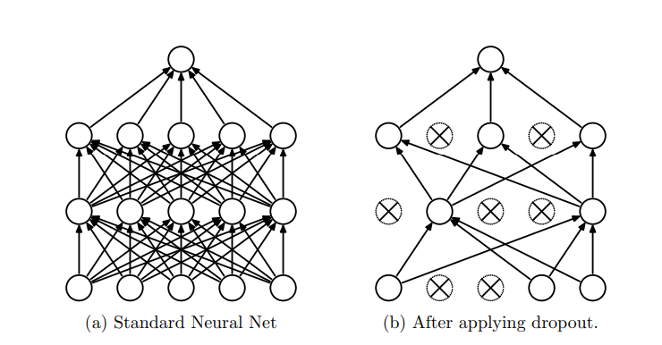
Regularization Techniques with Neural Networks
1. Dropout
Notes:
When Explaining Dropout, asks them what they think it solves or if they can explain what co-adaptation is
Also briefly talk about Early Stopping and Weight Decay (If they do not remember what weight decay is refer them to Dr. Isaac’s last class)

Slide 13
Types of Neural Networks
Feed-Forward Neural Networks
Convolutional Neural Networks
Recurrent Neural Networks
Long-Short Term Neural Networks (LSTMs)
Transformers
Notes:
Feed forward Neural Networks – Used for basic regression and classification tasks
Convolutional Neural Networks – Specific to facial recognition, image detection etc.
Recurrent Neural Networks – Sequential tasks, use capstone as example
LSTMs – Use capstone as example
Transformers – ChatGPT

Slide 14
Limitations of Neural Networks
Large Data Requirement
Computationally Expensive (Both time and Resources)
Prone to Overfitting
Difficulty in Finding Optimal Hyperparameters
Large Model Size

Slide 15
Thank You!
Notes:
With this Slide show your calculations and walk through with the students.
Emphasize that this is how neural networks obtain the output High level overview: The input data is fed into the network and it flows forward through the network till the output is calculated

Slide 16
Any Questions ?
Notes:
With this Slide show your calculations and walk through with the students.
Emphasize that this is how neural networks obtain the output High level overview: The input data is fed into the network and it flows forward through the network till the output is calculated

